Slide 1
Normalized and Graph Cuts

Slide 2
Introduction to Graph-based Segmentation
Image segmentation aims to partition an image into meaningful regions (e.g., organs, tumors, tissues).
Graph-based segmentation treats an image as a graph G=(V,E)
V: set of nodes (pixels or superpixels)
E: edges connecting nodes, weighted by similarity (w(i, j)) based on intensity, color, or texture.
The goal is to cut the graph into disjoint sets such that the similarity within regions is high and dissimilarity between regions is high.

Slide 3

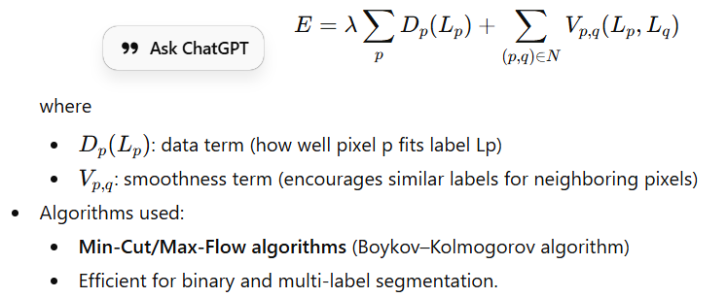

Principle of Graph Cuts
Graph Cut methods aim to partition the graph into two disjoint sets $A$and $B$by minimizing a cost function:
This measures the total dissimilarity between the two groups.
To find an optimal segmentation, energy minimization frameworks are used:
Example:
In medical images, graph cuts can be used to segment structures like the brain tumor or blood vessels, where intensity contrast helps define boundaries.

Slide 4

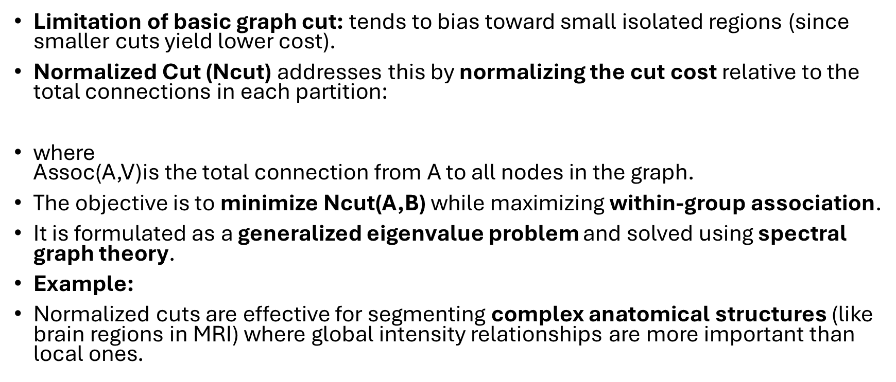
Principle of Normalized Cuts
Limitation of basic graph cut: tends to bias toward small isolated regions (since smaller cuts yield lower cost).
Normalized Cut (Ncut) addresses this by normalizing the cut cost relative to the total connections in each partition:
where $\text{Assoc}\text{(}\text{A}\text{,}\text{V}\text{)}$is the total connection from A to all nodes in the graph.
The objective is to minimize Ncut(A,B) while maximizing within-group association.
It is formulated as a generalized eigenvalue problem and solved using spectral graph theory.
Example:
Normalized cuts are effective for segmenting complex anatomical structures (like brain regions in MRI) where global intensity relationships are more important than local ones.

Slide 5
Strengths and Limitations in Medical Image Segmentation
Aspect | Graph Cuts | Normalized Cuts
Strengths | - Globally optimal segmentation (binary). - Handles noise with smoothness term. - Fast implementations (min-cut/max-flow). | - Avoids small region bias. - Considers global image properties. - Good for multi-region segmentation.
Limitations | - Bias toward small regions. - Sensitive to initialization (seed points). - May need prior knowledge of object boundaries. | - Computationally expensive (eigenvalue decomposition). - Difficult for large 3D medical volumes. - Sensitive to choice of similarity metric.
Applications in Medical Imaging | Tumor segmentation, organ boundary extraction, vessel detection | Brain tissue segmentation, complex organ separation

Slide 6
Comparative Summary
Both Graph Cuts and Normalized Cuts are powerful graph-based segmentation techniques.
Graph Cuts are efficient and suitable for binary segmentation with interactive user input.
Normalized Cuts provide balanced partitioning for multi-region segmentation and global coherence, though at a higher computational cost.
In practice, hybrid methods and deep learning-graph cut combinations are used in modern medical image analysis to overcome these limitations.

